Slide 1
CPU
CB #1
CB #2
CB #3
CB #4
GPU idle
GPU idle
GPU idle
GPU
CB #1
CB #2
CB #3
CB #4
Time
CPU
CB #1
CB #2
CB #3
CB #4
GPU
CB #1
CB #2
CB #3
CB #4
Time

Slide 2
Instance of HelloVulkanApp object
Start
Initialize
Render Loop
CleanUp
End
1
4
5
8
10
HelloVulkanApp
Update()
Configure()
Setup()
Close
Render()
2
3
6
7
9
VulkanApp
CreateWindow()
Run()
Present()
CoreCleanup

Slide 3
Setup
Render Loop
Close
Start
End
User Inputs

Slide 4
Instance
SPIR-V shaders
Instance
Pipeline
Layout
Instance
Shader Objects
Instance
Physical Devices
Enumerated Devices
Graphics
Pipeline
Vulkan Device
Render Pass
Command Pool
Graphics Queue
Present Queue
Swap Chain Image 0
Swap Chain Image View 0
Frame Buffer 0
Command Buffer 0
Swap Chain
…
…
…
…
Swap Chain Image N
Swap Chain Image View N
Frame Buffer N
Command
Buffer N

Slide 5

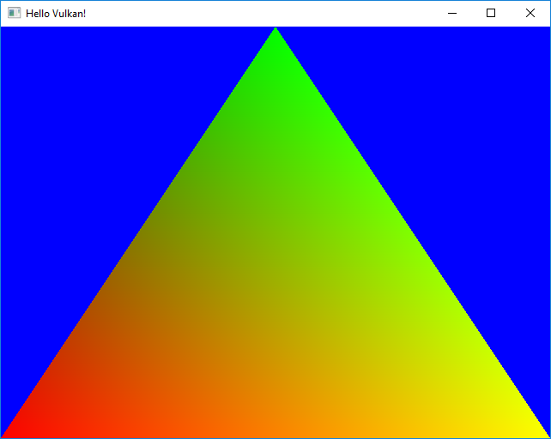
Render Syncrhonization
Active Frame Buffer
Vulkan Commands to draw a triangle
vkCmdBeginRenderPass()
vkCmdBindPipeline()
vkCmdDraw()
vkCmdEndRenderPass()
vkEndCommandBuffer()
Active Command Buffer
vkQueueSubmit
GPU
Graphics Queue
Vulkan Objects to draw a triangle
RenderPass
Graphics Pipeline (+ shader objects)
Present Queue
vkQueuePresentKHR
Present
Syncrhonization

